Slide 1
Reproductive physiology

Slide 2
Unit 1

Slide 3
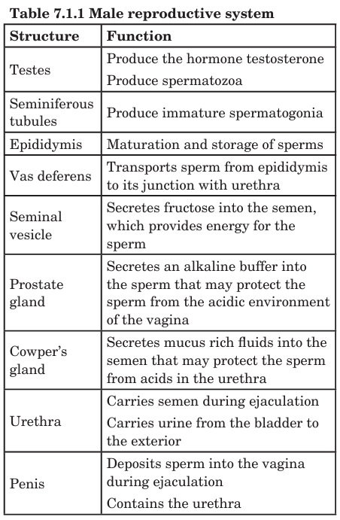
Male reproductive system

Slide 4
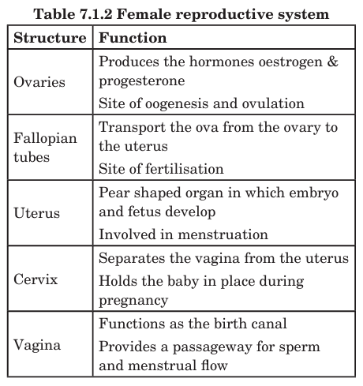
Female reproductive system

Slide 5
Unit 2

Slide 6
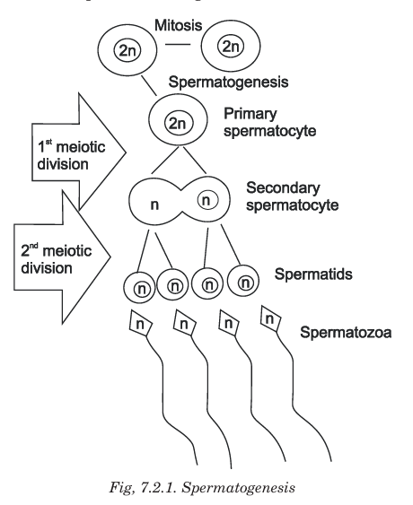

Slide 7
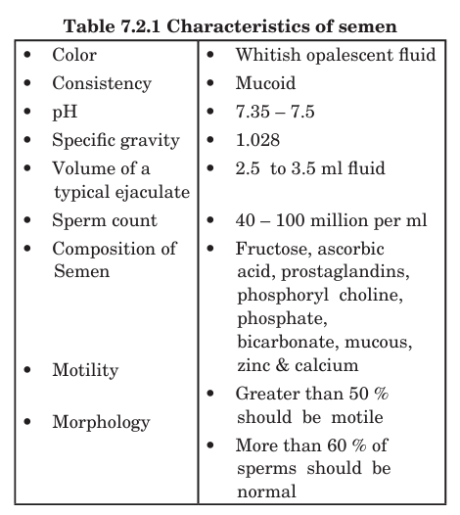

Slide 8
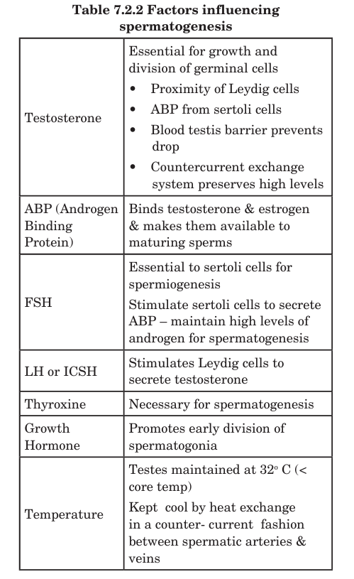

Slide 9
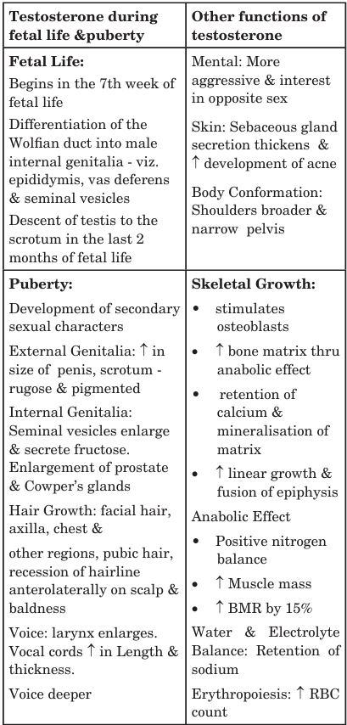
Function of testosterone

Slide 10
Unit 3

Slide 11
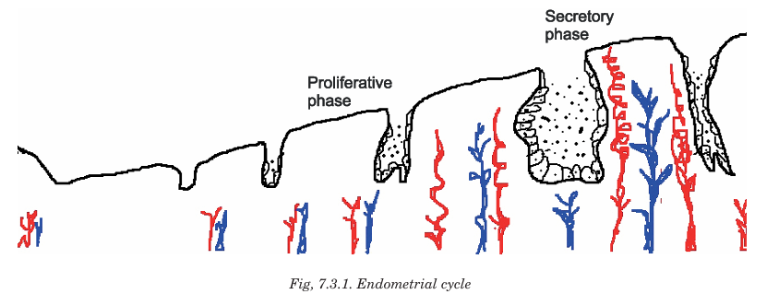

Slide 12
Ovarian cycle
Phase | Time (approx.) | Main Events
1. Follicular Phase | Day 1 – 14 | Development of ovarian follicle & secretion of estrogen
2. Ovulation | Day 14 | Release of mature ovum from ovary
3. Luteal Phase | Day 15 – 28 | Formation of corpus luteum & secretion of progesterone

Slide 13
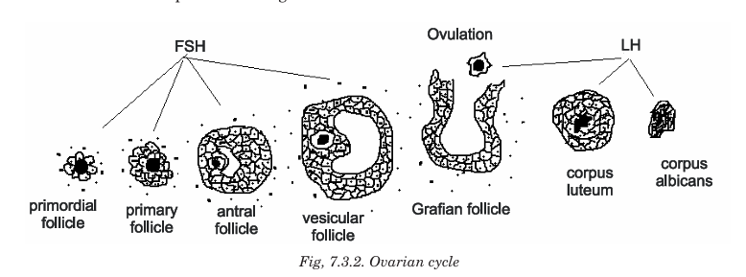

Slide 14
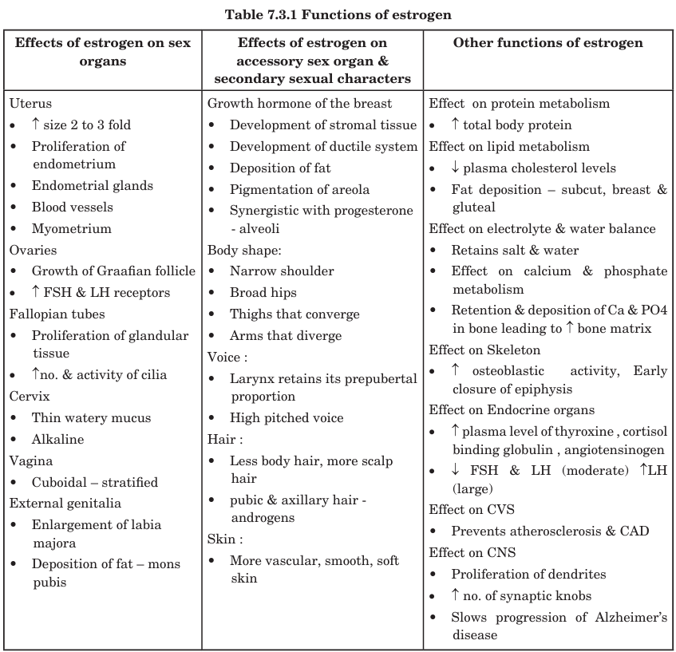

Slide 15
Test for ovulation
Basal body temperature
LH surge
Cervical mucus study
Ultrasonography
Mid cycle pain

Slide 16
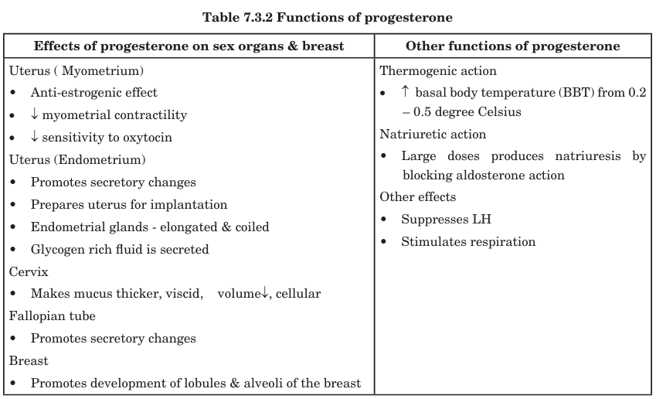

Slide 17
Unit 4

Slide 18
Function of placenta
Function Category | Role of Placenta
Respiratory | Exchange of O₂ & CO₂
Nutritive | Supplies nutrients
Excretory | Removes fetal waste
Protective | Selective barrier from toxins/infections
Endocrine | Secretes hormones (hCG, estrogen, progesterone, hPL)
Immune | Transfers maternal antibodies
Storage | Stores glycogen, fats, and iron

Slide 19
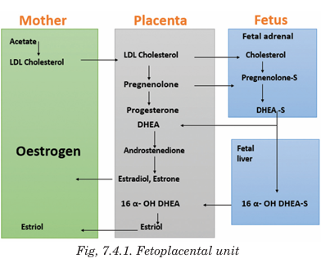

Slide 20
Types of Pregnancy Tests
Pregnancy can be checked using:
1️⃣ Urine Pregnancy Tests
2️⃣ Blood Pregnancy Tests
3️⃣ Ultrasound Examination

Slide 21
Urine Pregnancy Tests (Home Test / Rapid Card Test)
Most common and easy test
Detects hCG hormone in the urine
Can be done at home using pregnancy test kit
🔸 Result
Two lines = Positive (pregnant)
One line = Negative (not pregnant)
🔸 When to do?
Usually after missing a menstrual period (around 7–14 days after conception)

Slide 22
Blood Pregnancy Tests
Blood tests detect exact levels of hCG earlier and more accurately than urine tests.
Types of blood tests
Benefits
Detects pregnancy as early as 8–10 days after fertilization
Useful to detect: ectopic pregnancy risk of miscarriage multiple pregnancies (twins, triplets)
Type | What it shows
Qualitative hCG test | Tells if pregnancy is present (Yes/No)
Quantitative hCG test (Beta-hCG test) | Measures exact hCG level to monitor pregnancy growth

Slide 23
Ultrasound Test
Uses sound waves to visualize fetus and uterus
Not used to confirm pregnancy early, but to:
  Detect fetal heartbeat
  Locate fetus inside uterus
  Check gestational age and growth
When?
Usually done after 5–6 weeks of pregnancy to see fetal sac & heartbeat.

Slide 24
Other pregnancy tests
Test | Basis
Immunoassay tests | Detect hCG using antibodies
Radioimmunoassay | Very sensitive (lab-based)
Radio-receptor assay | Detects hCG using receptor binding

Slide 25
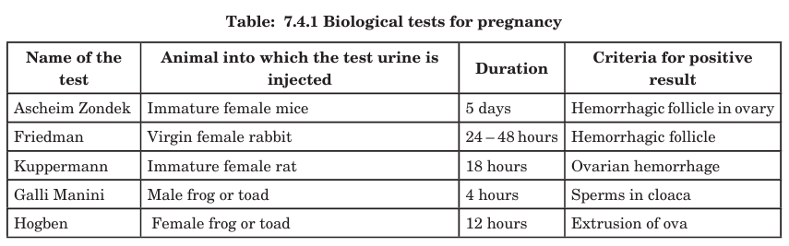

Slide 26
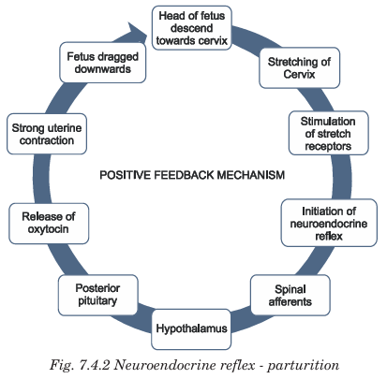

Slide 27
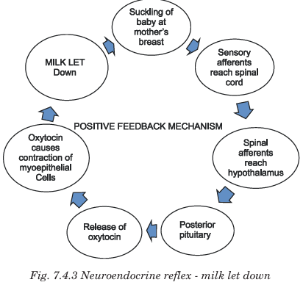

Slide 28
Unit 5

Slide 29
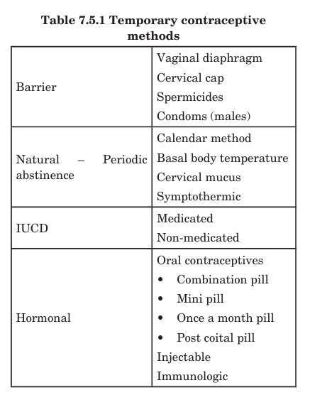

Slide 30
Permanent method of contraception
Vasectomy : vas deferens cut and tied
Tubectomy : fallopian tube cut and tied

